Slide 1


Next-Gen School ERP & LMS
AI-Powered • Smart • Scalable

Slide 2


The Challenge Schools Face Today
Manual Workload Crisis
Endless paperwork drowning productivity and innovation
Timetable Chaos
Complex scheduling conflicts causing daily disruptions
Fee Management Mess
Tracking payments manually leads to errors and delays
Attendance Tracking Issues
Paper-based systems miss critical patterns and insights
School leaders lose 40% of productive time on repetitive administrative tasks

Slide 3
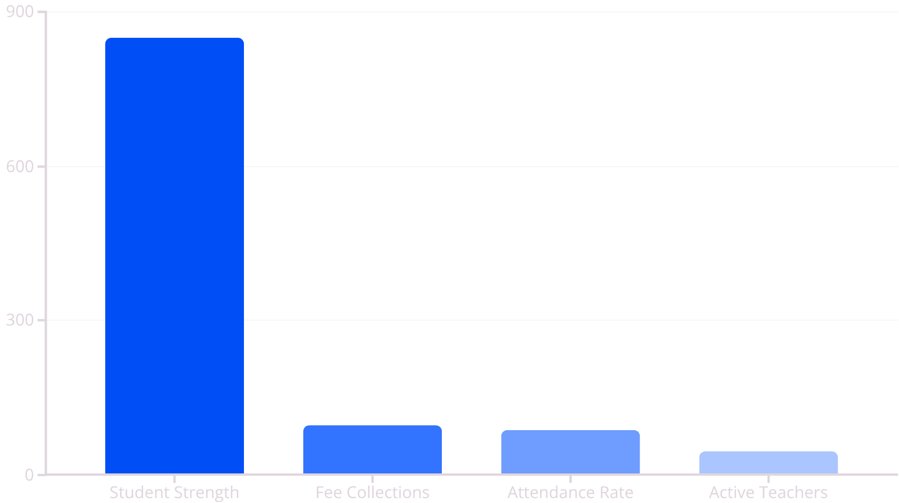
School Dashboard Overview
Real-time insights and quick actions at your fingertips
Quick Actions
Add New Student
Publish School Notice
Collect Fee Payments
Generate Reports
Schedule Parent Meeting

Slide 4




User Roles & Access Control
School Admin
Teachers
Complete system oversight: manage teachers, students, fees, notices, and generate comprehensive reports for strategic decision-making.
Streamlined workflow: mark attendance, enter grades, create assignments, upload study materials, and track student progress effortlessly.
Students
Parents
Personalized learning hub: access timetables, submit assignments, view grades, and follow customized LMS learning paths.
Stay connected: monitor fee payments, track attendance patterns, receive performance reports, and communicate with teachers.

Slide 5




Smart Attendance Management
Daily Capture
Quick digital attendance marking with smart device integration
Monthly Analytics
Automated report generation with trend analysis and insights
Smart Alerts
Proactive notifications for low attendance and intervention triggers
Visual heatmap displays attendance patterns, helping identify at-risk students and optimize classroom engagement strategies.

Slide 6

Exams & Gradebook System
Streamlined Exam Management
Performance Insights
Class toppers and improvement tracking
Automated exam scheduling across all grades
Subject-wise average comparisons
Instant notifications to students and parents
Weak performer identification
Digital marks entry with validation checks
Parent-teacher conference scheduling
Auto-calculated grades and rankings

Slide 7

Comprehensive Fees Management
Flexible Fee Structures
Customizable fee categories per class with installment options and scholarships
Secure Online Payments
Multiple payment gateways with bank integration and real-time processing
Smart Reminders
Automated due date notifications via SMS, email, and app push notifications
Digital Documentation
Instant receipts, invoices, and comprehensive financial reporting for transparency

Slide 8

Communication & Calendar Hub
Instant Announcements
Multi-Channel Reach
One-click broadcast to targeted groups: parents, teachers, or specific classes with delivery confirmation
SMS, email, app notifications, and web portal updates ensure no message is missed
1
2
3
Event Management
Centralized calendar for holidays, exams, sports events, and parent-teacher meetings

Slide 9

Integrated Learning Management System
01
Rich Content Library
Upload PDFs, videos, presentations, and interactive materials with organized course structure
02
Assignment Workflow
Create, distribute, and collect assignments with plagiarism detection and deadline tracking
03
Smart Assessment
Auto-graded quizzes plus subjective evaluation tools with detailed feedback options
04
Progress Analytics
Individual student learning paths with performance insights and personalized recommendations

Slide 10

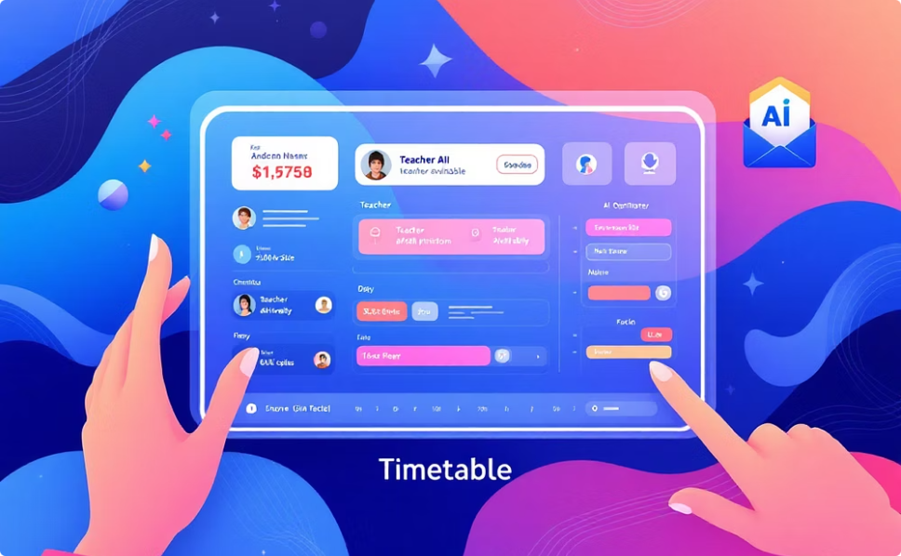
AI-Powered Intelligence Features
RAG-Powered Knowledge Assistant
Auto Timetable Scheduler
Intelligent chatbot answers student, teacher, and parent queries instantly by analyzing uploaded study materials, school policies, and academic documents.
AI generates optimal class schedules considering teacher availability, subject load distribution, and automatic substitution management for seamless operations.
40%
2x
99%
25%
Less Admin Work
Faster Scheduling
Digital Payments
Better Outcomes
Reduction in manual administrative tasks
Improved timetable creation speed
Fee collection digitization rate
Improvement in student performance metrics

Slide 11





Ready to Transform Your School?
Our comprehensive School ERP & LMS platform is designed to empower your institution, streamline operations, and foster a thriving learning environment.
Streamlined Administration
Optimized Scheduling
Automate tasks and reduce manual workload for staff.
Create efficient timetables with AI, saving time and resources.
Enhanced Learning Outcomes
Improve student engagement and academic performance with powerful tools.
Contact us today to learn more and schedule a demo:
📞 Email: support@sysnut.com | 🌐 Website: www.sysnut.com
Empowering educators and students for a brighter, more efficient future.

